Slide 1

Exam System (simple platform for hosting online MCQ exams)
Group 9
Group Leader :–
Oishik Chowdhury (21CS8177)
Group Members :-
Jishnu Raj (21CS8178)
Tulika Ranjan (21CS8179)
Padala Nishanth (21CS8182)
Sobhag Bairwa (21CS8183)
Balli Chanukya (21CS8184)
Anoop Kumar Yadav (21CS8185)
Abhijit Kumar Sinha (21CS8186)
Ashish Prajapat (21CS8187)
Project Repository: https://github.com/oishik-c/exam-os-project

Slide 2
Problem Description
Develop a MCQ-Based Exam Platform that can be used for conducting online exams. The system may be used by course instructors for uploading their question bank along with answer keys and grading schemes, timing, etc.
Probable Features:
APIs to define Grading policies, question shuffling policies as per choice
Extract questions and answer choices by parsing a .txt file provided by the instructor and create/update the question bank
Enable the system to read (.txt file) the seating matrix pattern fed by instructor to ensure no two adjacent student receives the question & options in the same order
Provide marks just after the exam
Generate personal performance statistics & overall performance indicators
Ensure that server failure is handled through redundancy
The system satisfy the following requirements:
Enables user login from different terminals from different physical machines
Enables User registration and authentication (using some hash based password)
A user-friendly text interface with time to submit, answered-question tags
A multithreaded platform

Slide 3
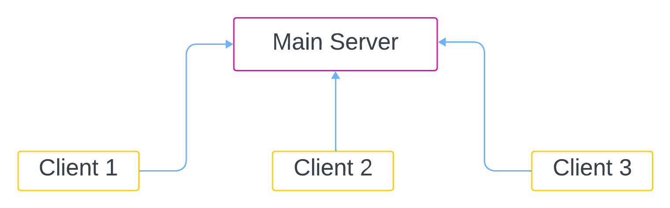
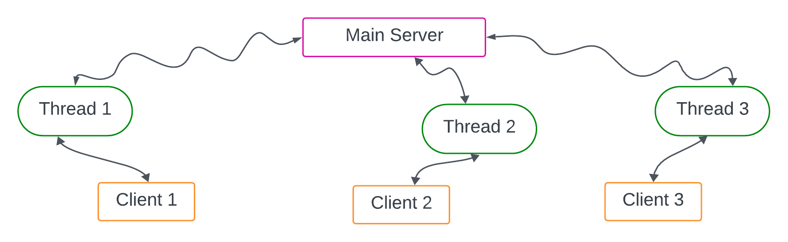
Schematic Overview of the System
Client-Server Architecture :
The server project runs on a remote machine.
The server can handle multiple clients at any point of time.
The clients request the server to provide a specific service to them.
The server creates a separate detachable thread to handle the request from a specific client using proper process/thread synchronizations.

Slide 4
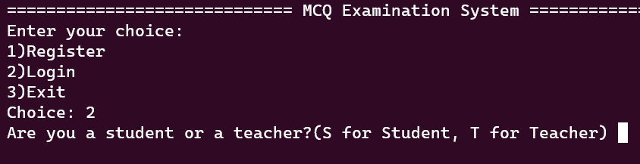
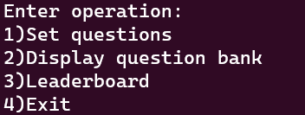
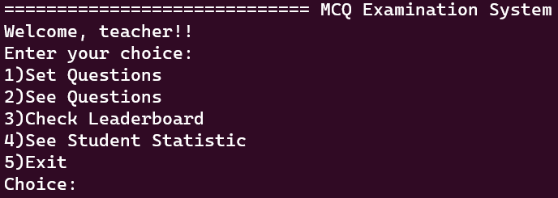
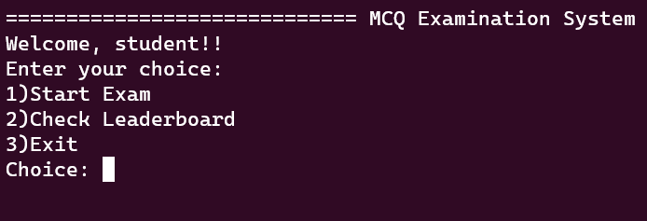
User Interface
Server
Client
Student
Teacher

Slide 5
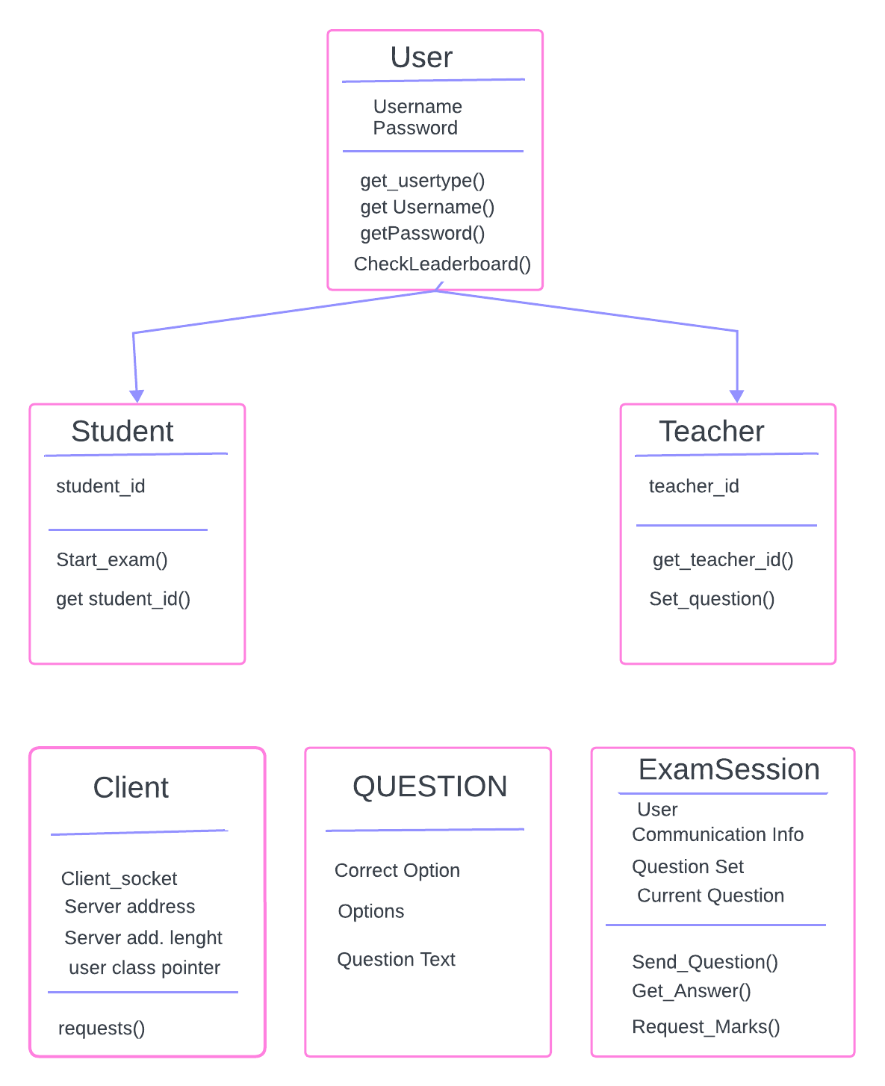
Design
Plan
of
Classes

Slide 6
Operating System Features Used
Shared Memory for communication of server/client processes on same devices.
Sockets for communication of server/client processes on different devices.
Multiple threads for handling different clients.
Semaphores/Mutex for synchronization of shared resources.
File Sharing and Handling for storage and inter-process communication.
User authentication and authorization mechanisms to control access to exam.

Slide 7
Application Level Features
Enable user login from different terminals from different physical machines.
Enable User registration and authentication (using some hash based password).
A user-friendly text-based interface indicating remaining time to submission and requested information to a user.
A multithreaded platform to control multiple client interaction with the server.
Random Question Generation to allow the system to generate random sets of questions from the question bank to reduce question predictability and cheating.
Leaderboard generation to enable users to get rank and related data and asses relative performance.
Cheating detection facility available for teachers, using statistical methods to catch potential cheating attempts.
Provide marks obtained just after the exam.

Slide 8
Thank You

